Slide 1
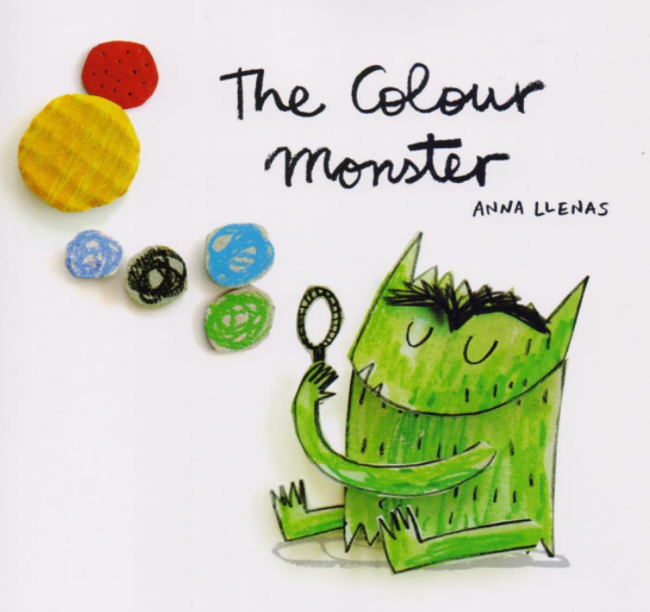
The Colour Monster
By Anna Llenas

Slide 2
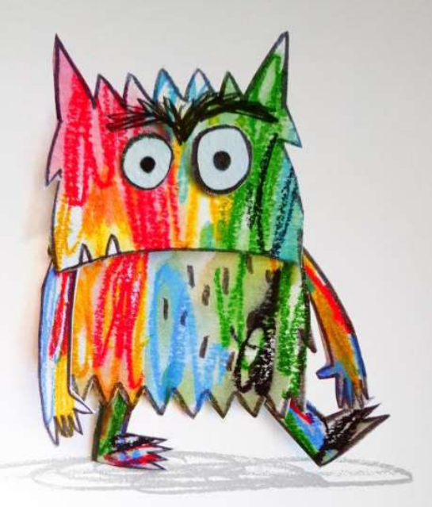
This is my friend the colour monster. Today he’s all mixed up and very confused.
He doesn’t know why.

Slide 3
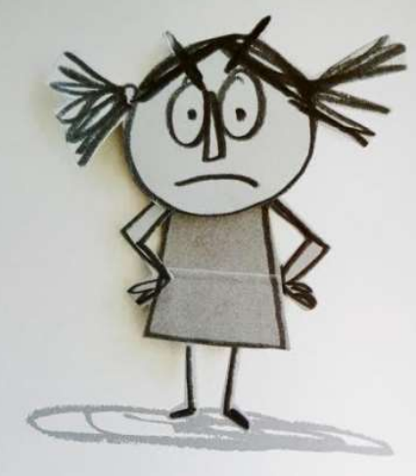
Look at you, you're all over the place!

Slide 4
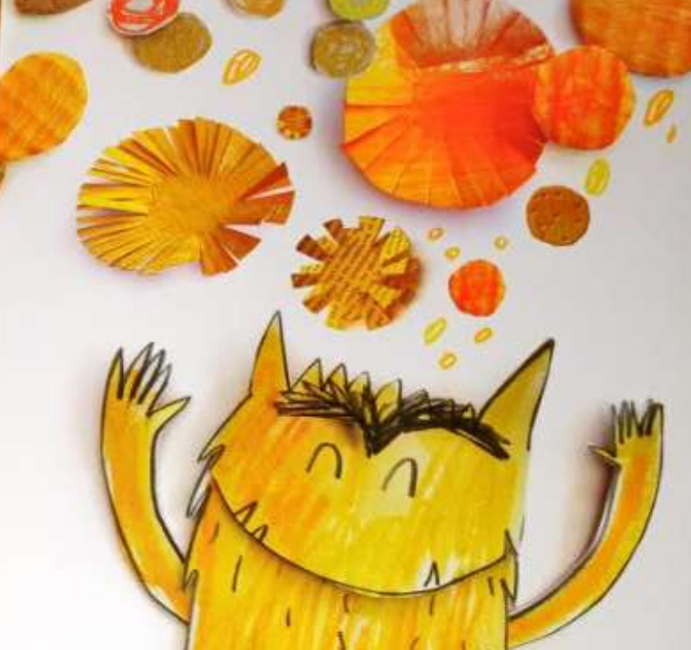
This is happiness. It shines yellow like the sun and twinkles like the stars.

Slide 5
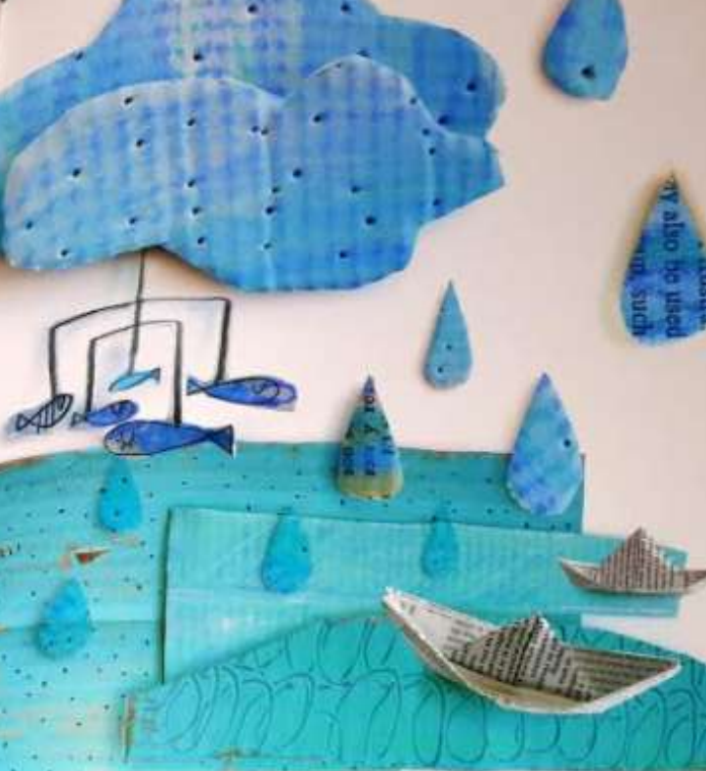
This is sadness. It's gentle like a blue rainy dаy.

Slide 6
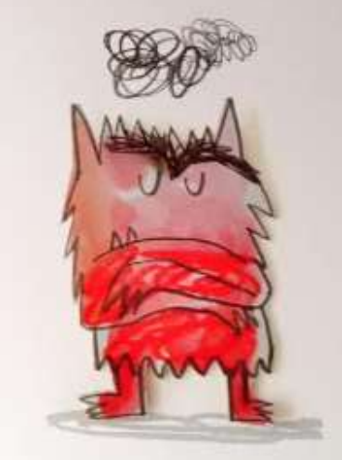
This is anger. It blazes red like fire.

Slide 7
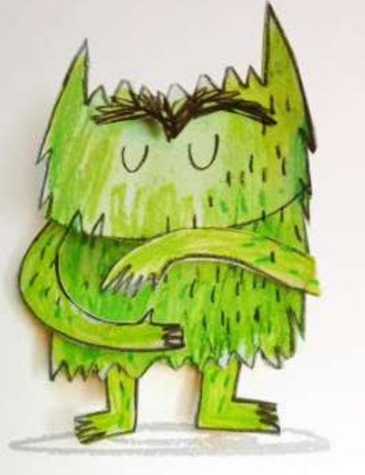
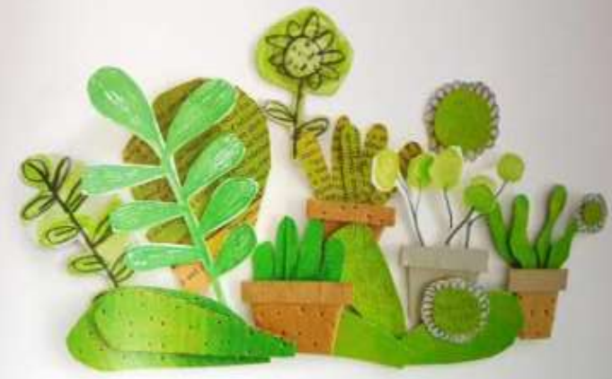
This is calm. It's quiet like the trees and soft like their leaves.

Slide 8
